Slide 1
DATA CLEANING
OBJECTIVE: DATA CLEANING ON LENDING DATA

Slide 2

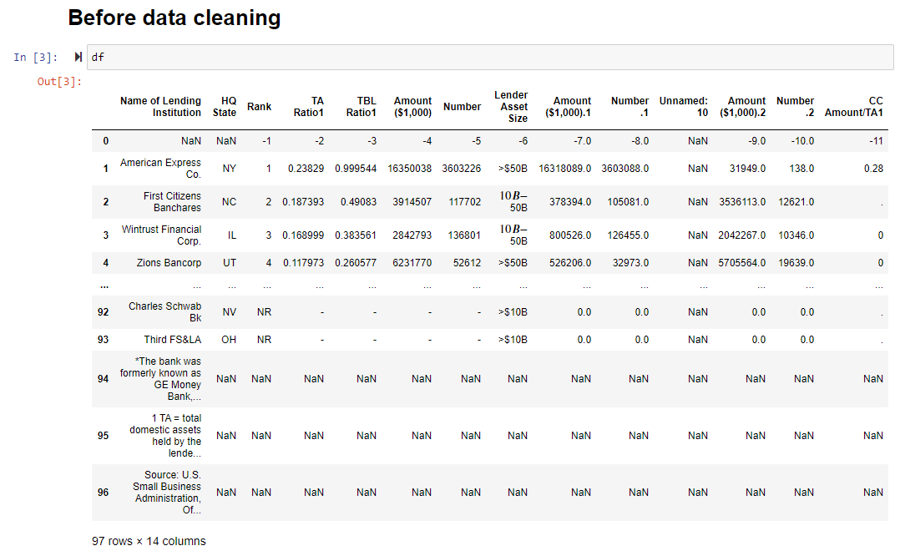
DATA HAS NULL VALUES

Slide 3
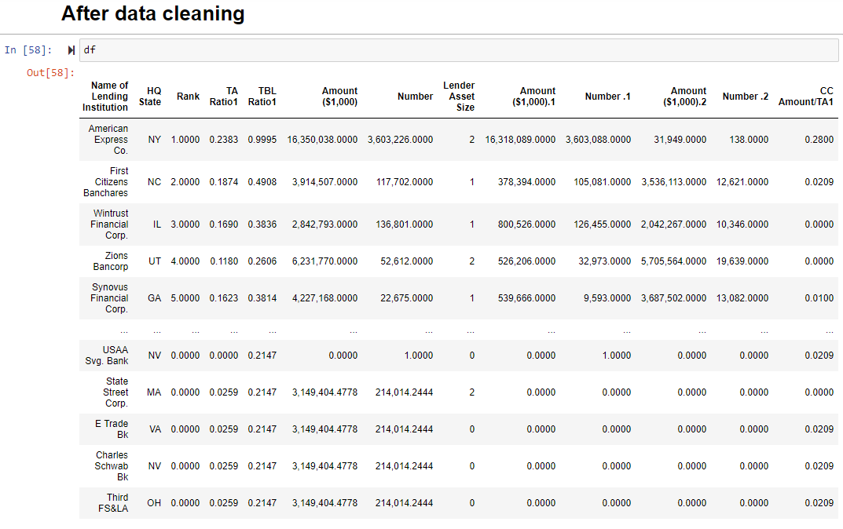
REMOVED NULL VALUES FROM DATA

Slide 4
Clean Rank with Matching Ranking value or '0'. if it is zero why?
DATA TYPE OF RANK COLUMN IS UPDATED TO FLOAT AND THE 'NR' VALUES WERE REPLACEED WITH '0'
THE 'NR' VALUES WERE REPLACED WITH 0 SINCE THE COMPANIES WERE NOT RANKED

Slide 5
Clean '-' values with column mean
COMMANDS USED (example):
df.replace('-', np.nan)
df[['TA Ratio1','TBL Ratio1','Amount ($1,000)','Number ']]= df[['TA Ratio1','TBL Ratio1','Amount ($1,000)','Number ']].replace('-', np.nan)
df['TBL Ratio1']= df['TBL Ratio1'].fillna(df['TBL Ratio1'].mean())
THE VALUES ' - ' FROM THE COLUMNS WERE REPLACED BY THE RESPECTIVE COLUMN MEAN

Slide 6
Clean '.' with column mean
COMMANDS USED:
df['CC Amount/TA1']= df['CC Amount/TA1'].replace(' . ',np.nan)
df['CC Amount/TA1']=df['CC Amount/TA1'].astype(float)
df['CC Amount/TA1']= df['CC Amount/TA1'].replace(np.nan,df['CC Amount/TA1'].mean())
THE ' . ' VALUES WERE REMOVED FROM 'CC Amount/TA1' COLUMN AND THE DATA TYPE IS UPDATED TO FLOAT

Slide 7
Convert Lending Asset Size = Category like 0, 1, 2 etc based on levels available
COMMANDS USED:
df['Lender Asset Size'].value_counts()
df['Lender Asset Size'] = df['Lender Asset Size'].replace(regex=True, to_replace='[^0-9]', value='')
from sklearn.preprocessing import LabelEncoder
df['Lender Asset Size'] = LabelEncoder().fit_transform(df['Lender Asset Size'])
USING LABELECODER FROM SKLEARN THE VALUES (LEVELS) OF THE LENDING ASSET SIZE WAS CODED TO 0,1,2

Slide 8
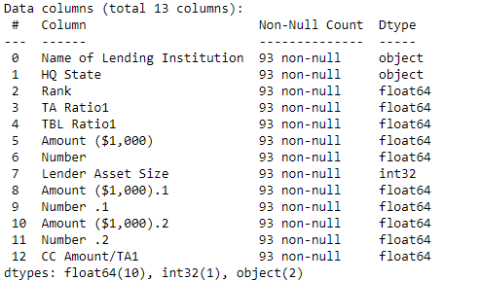
MAKE SURE EVERY COLUMN IS IN ITS RESPECTIVE DATA TYPE
THE DATA TYPES OF THE VARIABLES ARE UPDATED AS PER THEIR RESPECTIVE TYPES

